Slide 1



Advancing local pharmaceutical production through legislation and institutional reforms in the ESA region
Southern and Eastern African Trade Information and Negotiations Institute (SEATINI)
AFYA na Haki
IN EQUINET

Slide 2
The issue
Pharmaceutical production in Africa and the ESA region is affected by several factors and deficits and incapacities in:
research and development,
intellectual property rights,
established markets, regulation,
human and technical skills,
capital markets for finance and;
competition laws and policies

Slide 3

The Challenge
Africa continues to rely on other continents for the procurement of Essential Health Products (EHP):
  medicines, vaccines, therapeutics, diagnostics, PPE, etc .
This affects the costs of all EHPs
Impacts on access to EHPs
COVID-19 highlighted the urgent need for local production of EHP

Slide 4
Our work aimed to
investigate and provide evidence on progress in policy, regulatory, legislative and institutional reforms in the ESA region for local production of pharmaceuticals (essential health products, EHPs)
enhance the knowledge and understanding of EHPs local production among the key stakeholders including for purposes of advocacy and engagement with relevant authorities;
Review progress made in the implementation of the Partnerships for African Vaccine Manufacturing (PAVM) objectives

Slide 5
Findings
Plans, policies and strategies for local pharmaceutical production
  Pharmaceutical Manufacturing Plan for Africa-African Union 2007
  2nd EAC Regional Pharmaceutical Manufacturing Plan of Action 2017–2027
  SADC Pharmaceutical Business Plan 2015-2019
  SADC Industrialization Strategy and Roadmap 2015 – 2063
    Strategy on Regional Manufacturing of Essential Medicines and Health Commodities (2016-2020)
  Partnerships for African Vaccine Manufacturing (PAVM) 2021

Slide 6
National plans and strategies
Extensive policy and legal measures, e.g.
National Pharmaceutical plans, Policies and strategies
National health policies
National development plans and strategies
Industrial Development policies (National industrial policy)
National drug policies (e.g. Uganda National Drug Policy 2002)
National Medicines Policies (Zimbabwe National Medicines Policy (ZNMP) (2011)
National visions (e.g. Kenya Vision 2030; Uganda Vision 20240)
The challenge of local pharmaceutical production does not appear to be a lack of policies and laws, but in their implementation

Slide 7
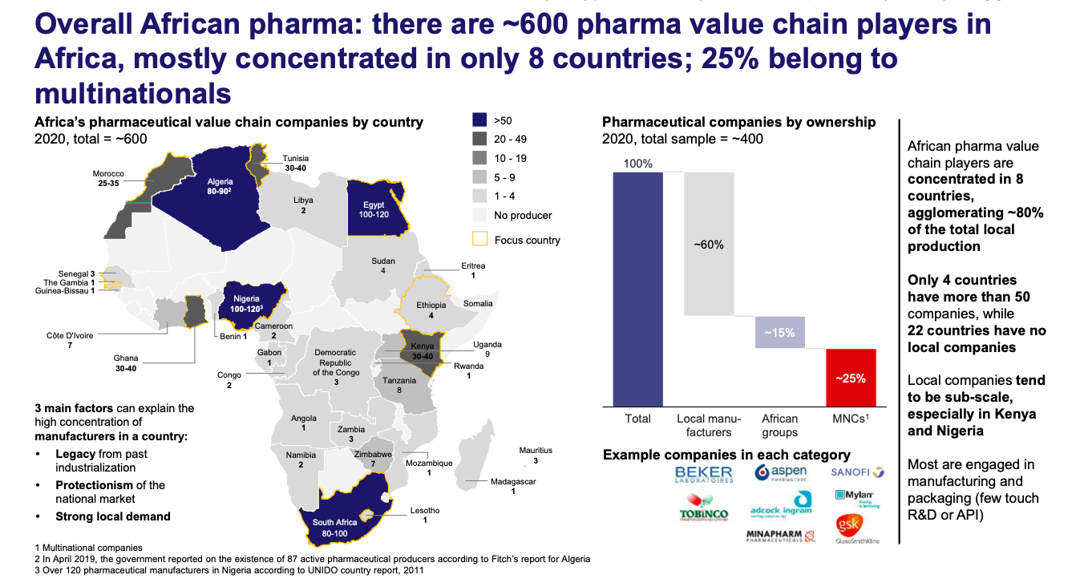
Findings
ESA’s pharmaceutical production context
South Africa (80-100)
Kenya (30-40)
Uganda (9)
Zimbabwe (7)
Source: PAVM, 2021

Slide 8
ESA’s pharmaceutical production context
Most producers engage in drug product manufacturing and packaging and not in R&D or production of Active Pharmaceutical Ingredients (APIs)
  they purchase APIs from other manufacturers and formulate them into finished pills, syrups, creams, capsules, and other finished drugs

Slide 9
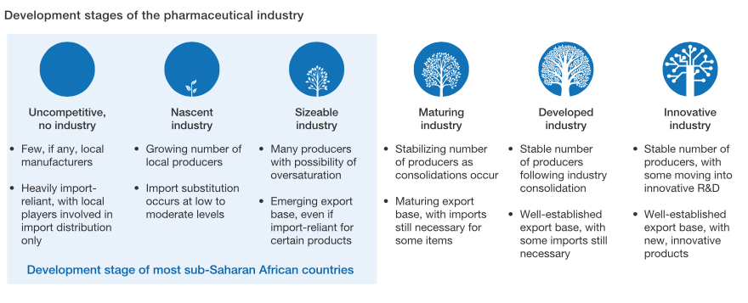
Development stages of pharmaceutical industry
Source: MacKensey & Company, 2019:2

Slide 10
Constraints to production
local production is constrained by:
  Availability of a viable and accessible local market,
  high costs related to very old plants and equipment;
  Availability and retention of skilled workers (Human resources in specialised sub-sectors)
  exorbitant utility tariffs (water, electricity);
  lack of working capital including access to capital for recapitalisation;
  lack of technology
  Effective regulation of medicines production, procurement and distribution

Slide 11
Addressing the constraints: Market creation-AfCFTA
Negotiations for the creation of the AfCFTA
  launched on 15 June 2015 and concluded in March 2018 with the adoption of the AfCFTA Agreement and its three protocols on goods, services and dispute settlement;
  In February 2023 tree protocols were adopted (Investment, intellectual property, competition policy)
As of June 2023, 54 countries-signed, 46 countries have ratified, that is taking the necessary legal processes at the national level to domesticate and implement it;
All ESA countries signed the agreement;

Slide 12
AfCFTA
AfCFTA objective:
  elimination of tariff and non-tariff barriers amongst the African countries;
  facilitate movement of persons, thus deepening economic integration of the continent;
The AfCFTA seeks to operate a single market of 1.2 billion people with potential of becoming the largest regional economic bloc in the world based on the number of countries involved;
It is expected to boost intra-Africa trade currently accounting for only 12% of trade for Africa;

Slide 13
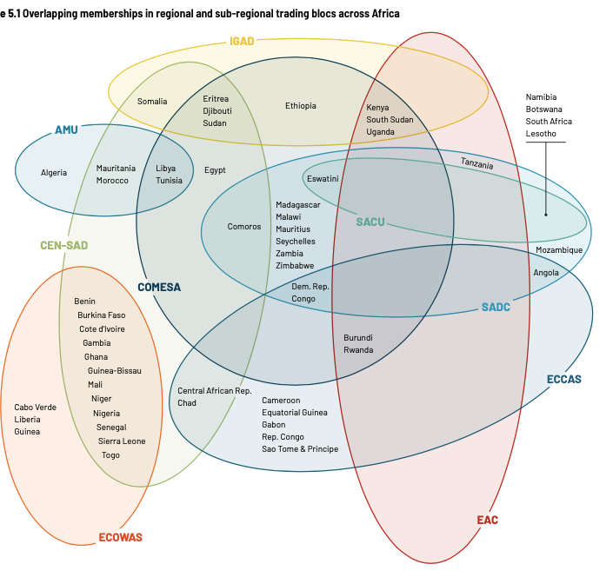
Progress in addressing the constraints: Market creation-AfCFTA

Slide 14
PAVM Interventions
PAVM has a pillar on supporting enabling trade policies for vaccines – all guided by a continental strategy with a delivery and oversight mechanism;
  Non tariff barriers (licensing requirements, SPS, prohibitive legislation)
  Free movement of people across the continent

Slide 15
Trade policies and the manufacturing sector
Trade policies are an integral part of a manufacturing system:
Local production of pharmaceuticals depend on trade policies particularly:
  Import duty exemptions on raw materials
  Harmonisation of trade and industrial policies
  Policy coordination eg for industrial parks, special economic zones, pharmaceutical parks
  Ratification and implementation of agreements for intra-regional and continental trade & distribution

Slide 16
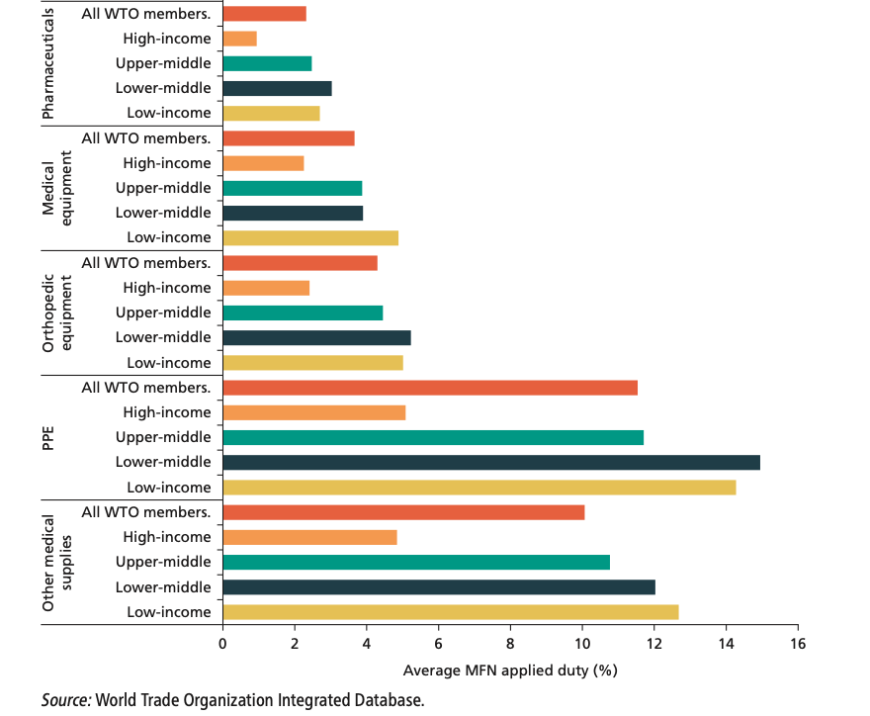
Tariffs on medical product groups
Average MFN tariff on medical goods 5%, (8% for manufactured goods)
MFN tariffs in HICs average 2.4 %
Pharma products have lowest MFN applied tariffs
PPE -highest duties (twice the average for all medical goods). Average tariff on textile face masks is 13.5%.

Slide 17
Skills development
ESA countries have been affected by a shortage of human resources for health (HRH):
including those in pharmaceutical, biotechnology, engineering and laboratory scientist and technicians.
This has been attributed to:
  inadequate training,
  production and retention of health professionals,
  brain drain of locally produced human capital thus resulting in foreign recruitment of the health workforce.
Investment in human resources is a pivotal enabler of a strong, innovative and sustainable local production industry.
Foreign recruitment of specialised workforce (industrial pharmacists, biotechnologists, engineers, laboratory scientists, management etc) is a huge cost driver particularly for the local pharmaceutical and vaccines production industry;
Mature pharmaceuticals or vaccine production industry requires highly specialised skills in industrial processes;
The skills are not only required for manufacturing processes but also for the entire value chain (research capacity, laboratory networks, analytics, ICT, ancillary supplies, logistics and distribution networks)

Slide 18
Human Resource for Health Development
Country | Strategy for HRH
Angola | Not available
Botswana | Health sector Human Resource Development Plan (2016
DRC | HRH strategic plan (Plan National de Development des Resources Humaines Pour la Sante (PNDRHS), 2011-2020)
Eswatini | Human Resources for Health Strategic Plan 2012-2017
Kenya | Human Resource for Health Strategy (2019-2023)
Kingdom of Lesotho | Human Resources Development & Strategic Plan 2005-2025
Malawi | Human Resources for Health Strategic Plan, 2018-2022
Mauritius | Health sector strategy, 2020-2024
Mozambique | Health sector strategic Plan 2014-2019
Namibia | Five-year Human Resource Strategy for Health
South Africa | 2030 Human Resources for Health Strategy: Investing in the Health Workforce for Universal Health Coverage
Tanzania | Heath sector Strategic Plan July 2021-June 2026
Uganda | Human Resources for Health Strategic Plan 2020-2030
Zambia | National Human Resources for health strategic plan 2018-2022
Zimbabwe | National Health Strategy 2021-2025
SADC | Health work force strategic plan 2020-2030

Slide 19
Skills development
ESA countries have developed strategic plans for human resource development in the health sector;
Some of the plans are not explicit particularly for the training of critical resources required for local production although they do recognise the importance of technical human resources;
Some, like the Kingdom of Lesotho, point to the training of biomedical engineers, laboratory technologists and technicians;
The Botswana plan focuses on improved quality of education and training, employment creation and productivity, research innovation and development and skills development without elaborating on the specificities;
Tanzania plan does not explicitly make clear the strategy for training specific human resources for pharmaceutical production, it outlines government’s commitment to strengthen domestic pharmaceutical manufacturing, as well as research and development;
Kenya strategy for health products and technologies (HPT) supply chain for 2020-2025 shows that than 40 institutions offer specialised training in pharmaceutical analysis, Industrial Pharmacy, Pharmacovigilance and Pharmaco-epidemiology, Pharmacology, Clinical practice, and Toxicology;

Slide 20
PAVM-interventions
Africa CDC, WHO and has started supporting professionals from Africa to acquire skills in different areas:
course for standard practice (GxP) to equip the professionals representing the biomanufacturing workforce from LMICs with the essential skills required to operate according to current good practices. This course focusses on:
  Good Laboratory Practice (GLP)
  Good Clinical Practice (GCP)
  Good Clinical Laboratory Practice (GCLP)
  Good Manufacturing Practice (GMP)
  Biosafety

Slide 21
PAVM interventions
In partnership with Texas A&M National Centre for Therapeutics Manufacturing in College Station;
Offering courses in:
  biopharmaceutical manufacturing
  Biomanufacturing of vectors for gene therapy
  mRNA Vaccine manufacturing
  Challenge:
  How can these courses be institutionalised at country level through state led collaboration with AU/Africa CDC

Slide 22
Medicines Regulation
Medicines Regulatory Harmonization (AMRH) programme in 2009:
  to facilitate and coordinate the harmonization of medicines regulation and improve access to quality, safe, efficacious and affordable medicines in Africa
One of the major milestones achieved by the AMRH is the development of the AU Model Law on Medical Products Regulation;
The Model Law was developed to contribute towards harmonizing medicines regulatory systems and providing an enabling environment for the development and scale-up of health technologies in Africa;
AMRH has 10 technical committees

Slide 23
African Medicines Quality Forum (AMQF);
African Medical Devices Forum (AMDF)
African Vaccines and the African Vaccines regulatory Forum (AVAREF)
Pharmacovigilance (PV)
African Blood Regulators Forum (ABRF)
Medicines Policy and Regulatory Reforms (MPRR)
Regulatory Capacity Development (RCD)
Good Manufacturing Practice (GMP)
Registration and Marketing Authorisation (MA)
Information Management System (IMS)

Slide 24
Domestication of the model law
Some researches on the the domestication of the African Union model law on medical products regulation (2021): the results show that
out of the 55 countries in Africa, 21 responded to the questionnaires
Of those, only 6 member states have domesticated the AU Model law;
The challenges encountered in the process of domesticating and implementing the Model Law include:
  the lack of human and financial resources;
  competing priorities at the national level;
  overlapping roles of government institutions; and
  the process of amending/repealing laws being slow and lengthy due to varying national contexts
Recommendation: This is a huge area for research and advocacy for civil society

Slide 25
Technology transfer
ESA countries have been grappling with intellectual property rules that have played a role in access to medicines, diagnostics, vaccines, and other related technologies;
The WTO’s Trade Related Aspects of Intellectual Property Rights is seen as a major obstacle for developing countries in their quest to develop their pharmaceutical industry simply because of the limitations it has on access to technology;
TRIPS Agreement was amended through the Protocol of 6 December 2005 that entered into force on 23 January 2017;
The amendment inserted a new Article 31bis into the Agreement as well as an Annex and Appendix;
These provide the legal basis for WTO members to:
grant special compulsory licences exclusively for the production and export of affordable generic medicines to other members that cannot domestically produce the needed medicines in sufficient quantities for their patients;

Slide 26
ESA countries that have ratified the WTO amended TRIPs Agreement
Country | Date of ratification
Botswana | 18 June 2014
Burundi | 12 December 2019
Eswatini | 23 May 2022
Kenya | 21 July 2015
Lesotho | 4 January 2016
Madagascar | 9 November 2017
Malawi | 24 July 2017
Mauritius | 16 April 2008
Namibia | 4 April 2023
Rwanda | 12 December 2011
Seychelles | 8 June 2016
South Africa | 23 February 2016
Tanzania | 14 March 2016
Uganda | 12 July 2010
Zambia | 10 August 2009

Slide 27
TRIPs Waiver for covid 19 vaccines
Rwanda took advantage of the WTO mechanism for compulsory licenses for importation of medicines for HIV and AIDS;
There were complications in applying this WTO mechanism leading to the medicines taking almost a year to arrive in Rwanda from Canada;
This exposed the challenges in applying TRIPS flexibilities related to regulatory issues, including government procurement rules, and to practices, including the procedures for notifying the WTO;
TRIPs waiver:
India and South Africa requested the WTO to waive the implementation, application and enforcement of four forms of IPRs covered by the TRIPS Agreement (copyright and related rights, industrial designs, patents and trade secrets);
Waiver granted which allows eligible members the legal rights to use the subject matter of a patent required for the production and supply of COVID-19 vaccines without the consent of the right holder to the extent necessary to address the COVID-19 pandemic
The subject matter referred to includes the ingredients and processes necessary for the manufacture of the COVID-19 vaccine;

Slide 28
AfCFTA IPR protocol
At the continental level, to allow for innovation, the member countries of the AU in February 2023 adopted the protocol on intellectual property rights as part of the AfCFTA;
On a level playing ground, IPRs could be useful to stimulate innovation and encourage research and development:
  offers incentives through royalties for a novel development with utility value;
  What is crucial is for governments to provide incentives and support to local talent to exploit their resources for innovative developments particularly in the fields of pharmaceutical technology, drug formulation and industrial processes;

Slide 29
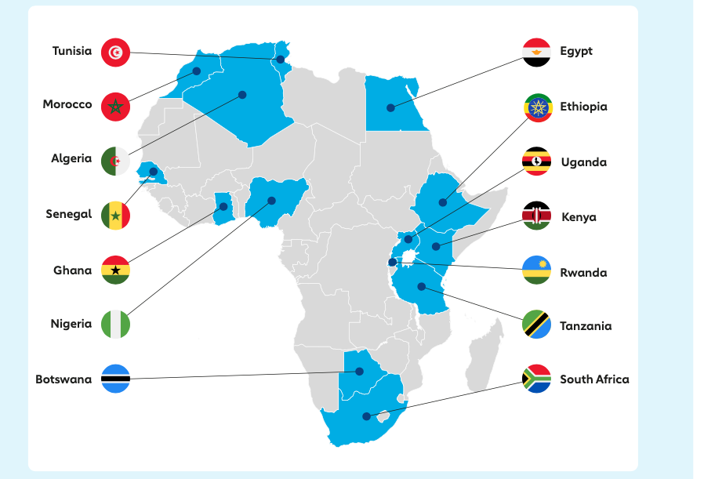
Vaccine manufacturing projects announced across 14 countries

Slide 30
Regional collaboration and partnerships
Vaccine manufacturing is a complex undertaking that might require pooled resources especially from countries that belong to the same REC;
In addition, the EAC is advanced in terms of integration, which could be beneficial for the four countries to agree to support and finance the establishment of a regional pharmaceutical manufacturing plant to cater for the region;
Mechanisms of sharing revenues could be obtained from other customs unions on how they have and continue to do it (e.g. SACU);
The different pieces of projects announced as shown in the map above might only use significant resources without advancement to maturity levels required:
Recommendation: CSOs could do more advocacy on regional pooling of resources to support perhaps two of the projects rather than disparate ones.

Slide 31
Other areas
Financing
Competition law and policy

Slide 32
Proposed Actions
Organise and communicate
Supporting the development of enabling legislation to facilitate implementation of agreed programmes at national level ;
identifying the different areas for legislation development and harmonisation that policy makers may undertake;
Advocate and engage
Contribute evidence and advocacy to African global engagement at different levels, and to remove obstacles to access and distributed production of all EHPs
Input to policy platforms
Contribute to and implement a monitoring and evaluation framework, including a peer review mechanism that ESA countries participate in, to enable alignment of national laws, regulations, plans and programmes to regional ones and peer learning within and across ESA countries;
Ensure that any flexibilities provided to countries include African countries and are used

