Slide 1
Assessment of the legal, policy and operational environment of pharmaceutical manufacturing associations in Africa
Denis Kibira, PhD
National Coordinator MeTA-Uganda
CEO- DUMAIC Global Health

Slide 2
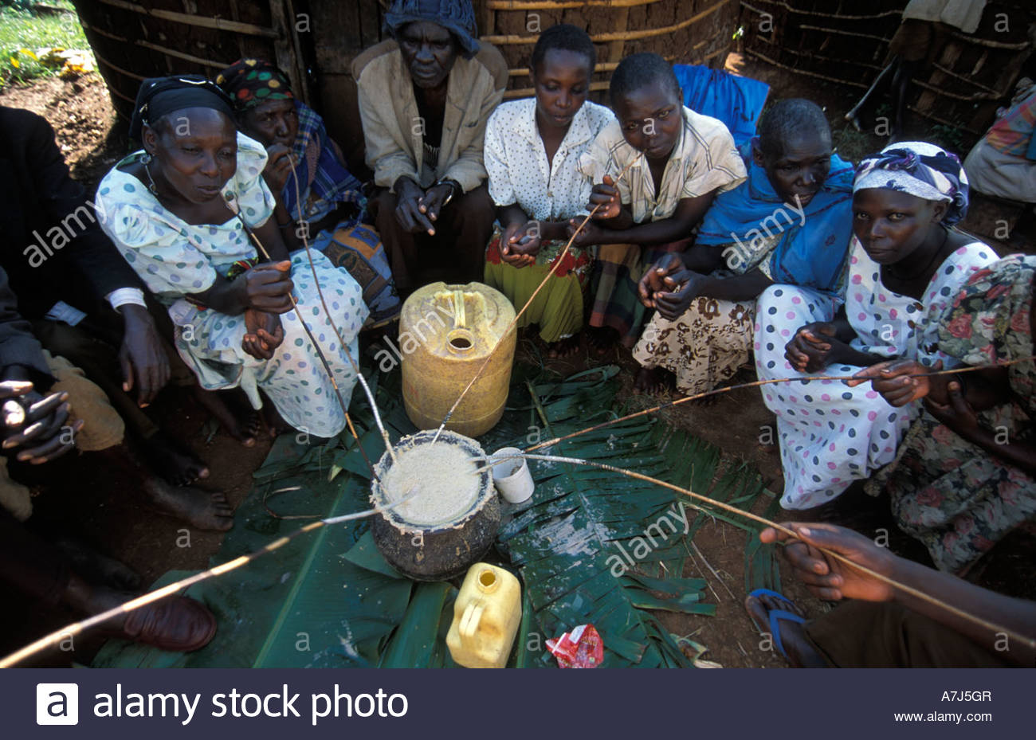
About MeTA & DUMAIC
MeTA is a multi-stakeholder platform to improve access to health commodities.
We are a catalyst/driver for change.
Core principles: Transparency and accountability
Priorities: Availability, Cost, Quality, Rational use of medicines
DUMAIC is the host of MeTA-Uganda: Working to advance innovative global health solutions through research, capacity building, policy engagement for health systems strengthening
Duma symbolizes power, speed, and grace

Slide 3
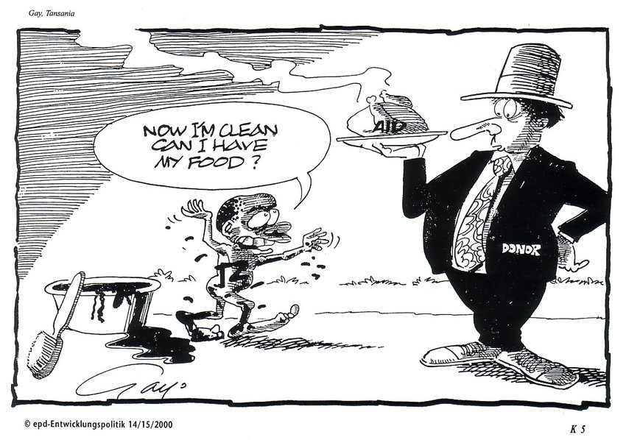
Medicines in Africa

Slide 4
Background
Africa accounts for 25% of the global disease burden, the bulk of infectious disease (75% of HIV/AIDS pandemic, 90% of malaria cases and deaths) and more than 50% of the global deaths of children under five.
Yet consumes only 1% of global healthcare expenditure.
1-in-3 people of the developing world are unable to access essential medicines.
The value of the Africa pharmaceutical industry is estimated at about $65 bn, whole health market of the continent is projected to reach $259 bn by 2030.
Sub-Saharan pharma market value is estimated at $14 bn but 70 - 90% of the medicines are imported mainly from China and India. Dependence on imports exposes the countries to unreliable supply chains
Pharma Manufacturing Associations play an important role in providing a voice for the industry.

Slide 5
Qns of Study
What are the governance and finance issues surrounding the operation of pharmaceutical manufacturing associations in the African region?
What are the roles of the pharmaceutical manufacturing associations across the region? And what roles are prescribed for these associations by the legal and policy frameworks? What roles should be prescribed by these frameworks?
How do pharmaceutical manufacturing associations engage with governments across the region?
How do pharmaceutical manufacturing associations engage with communities across the African region?

Slide 6
Methods
Study utilized qualitative methods
A mapping of relevant pharmaceutical manufacturing industry stakeholders
Document review of policies, reports, publications:
Published articles PubMed database were systematically searched and screened following a pre-defined strategy with key search words: (("pharmaceutical*"[Title/Abstract] OR "medicine*"[Title/Abstract] OR "drug*"[Title/Abstract]) AND ("manufactur*"[Title/Abstract] OR "production"[Title/Abstract])) AND ("association"[Title/Abstract] OR "society"[Title/Abstract]).
KII

Slide 7
Preliminary Findings

Slide 8
The Associations
Region/Country | Association
Continental | Federation of African Pharmaceutical Manufacturers Associations (FAPMA)
East Africa | Federation of East African Pharmaceutical Manufacturers (FEAPM)
SADC | South African Generics Manufacturers’ Association (SAGMA)
West Africa | West African Pharmaceutical Manufacturers’ Association (WAPMA)
Kenya | Kenya Association of Pharmaceutical Industry (KAPI)
South Africa | The Pharmaceutical Industry Association of South Africa (PIASA)
 | Innovative Pharmaceutical Association of South Africa (IPASA)
 | Generic and Biosimilar Medicines of Southern Africa (GBMSA)
Tanzania | Tanzania Pharmaceutical Manufacturers Association (TPMA)
Uganda | Uganda Pharmaceutical Manufacturers Association
Zambia | Zambia Pharmaceutical Manufacturers Association (PMA)
Zimbabwe | Zimbabwe Pharmaceutical Manufacturers Association (PMA)

Slide 9
Global and Regional Policy frameworks
Towards Access 2030: WHO Essential Medicines and Health Products Strategic Framework 2016-2030
WHO Global Strategy and Plan of Action on Public Health Innovation and Intellectual Property
WHO Local Production for Access to Medical Products: Developing a Framework to Improve Public Health 2011
African Union Model Law on Medical Products Regulation
Pharmaceutical Manufacturing Plan for Africa
Partnership on African Vaccine Manufacturing (PAVM) Framework for Action, 2022
African Continental Free Trade Area
The East African Community (EAC) Industrialization Policy 2012 – 2032
EAC Pharmaceutical Bill 2020
The 2nd EAC Regional Pharmaceutical Manufacturing Plan of Action (RPMPOA) 2017 – 2027
SADC Industrialisation Strategy
SADC Pharmaceutical Business Plan
Besides EAC RPMPOA the reviewed Policies did not mention Pharmaceutical Manufacturing Associations

Slide 10
Governance of the Associations
Established as voluntary non-profit organisations
Governed by Constitutions
Elected/nominated Board members:
Chairperson
Vice Chair
Secretary
Treasurer
Members
Secretariats: 1-2 staff
Key issues:
Secretariats depended on mostly donor projects
Most currently run on voluntary basis
Offices hosted by Chairperson or Coordinator
Limited visibility (website, social media presence)

Slide 11
Duties of the Associations
Platform for common voice
Research
Preparation of position/policy papers
Organise lobby and advocacy engagements
Trainings to members
Sharing of information and opportunities
Represents private sector on regional/continental advisory bodies e.g Africa Business Forum, AMRH, ZAZIBONA etc
Broker partnerships with innovators for tech transfer
Review of technical documents
Employee unions: wage negotiations

Slide 12
Financing
Sources:
Fees and payments from members
Donations Grants
Key issues:
Members’ contributions are meagre: 10-30% of budget raised
Reliance on support from donors: GIZ, UNIDO. This funding has run out
Don’t see possibility for Govt support

Slide 13
Collaborations with stakeholders
Involvement in activities: AUC, ACFTA, AMA, PMPA, AMRH, WHO, PEPFAR, Africa CDC (But no MoUs)
Memberships have extended to other e.g Professional Associations, Business associates, Academia (for SAGMA)
MoUs btn FAPMA, SAGMA with GF
8-year project support for regional associations with UNIDO; some funding by GIZ
Engagements with Govts have been for advocacy; advisory
Partnerships with MeTA Countries- MSE
Engagements with communities through CSOs and CSR medical outreaches

Slide 14
Key learnings
Pharma Manufacturing Associations fairly new on Continent
Soundly governed and well organized at continental, RECs, and country level
Successful initiatives already implemented
Major support for Secretariats and meetings through projects
No current existing donor projects
Very limited funding: Fees from members minimal
Activities are minimal and depend mostly on volunteers on the Boards: little visbility

Slide 15
Recommendations
Strengthen financing streams for functional Secretariats
Increase collaborations with academia and CSOs
Improve visibility: through websites, social media presence
Ensure more legitimacy through presence in Policy documents
Increase collaboration with Govts: presence on TWGs and other advisory bodies
PUBLISH, PUBLISH, PUBLISH

Slide 16
ASANTE SANA

