Slide 1
Pandemic Action Network
June 2023

Slide 2
The role of CSO’s in creation of enabling ecosystem for vaccine manufacturing in Africa
Notes:
Notes
Channel strategy notes - https://docs.google.com/spreadsheets/d/1eGfk_jh9YdusheZy19R_cJIBTLqrH93ZsrwQ1Lz8Y5g/edit?usp=sharing

Slide 3
Situation Analysis Challenges
Existing global systems are inadequate. The COVID pandemic spotlighted the failure of global solidarity and charity models to provide for Africa’s global health security.
Africa’s health systems are vulnerable. Across various key functions including health workforce, disease surveillance and laboratory systems, and health workforce capacity, African countries rank the lowest on global indices, making them vulnerable to climate and health shocks.
Africa lacks capacity to produce its own medical countermeasures. Research and development and manufacturing capacity is minimal on the continent. (~0.45% investment GDP for R&D; <2% R&D in Africa; Imports >80% of its consumed pharmaceutical).
Weak regulatory environment: Only ~5 Countries have reached WHO Maturity Level 3.
Low appreciation of the nexus between health and climate. African countries are particularly vulnerable to the impacts of climate change, but there is currently a low awareness of the connectedness between climate change impact and health/pandemic risks.
Resources do not meet the needs. Health spending on the continent is below level and budgets are even tighter since COVID; high dependence on external health financing.
Governance of health systems is weak and inequitable. Current governance structures for health at national, regional, and global levels are disjointed, inadequate, and lack transparency/accountability.

Slide 4
The equity challenge in access to Pandemic Countermeasures…
Response to the COVID pandemic was far from equitable.
The response showed that the current system for the development, production, allocation, and distribution of pandemic countermeasures is trapped in a market-driven charity frame.
This system is based on a business model for health technologies that prioritizes financial and self-interests over health.
It is characterized by a fundamental inequity in technological capacity to create and own innovations.
Equitable access is only considered at the procurement phase of product development and distribution, which results in products that are not suitable, tested for, or equitable for all settings, and an unsustainable race for unpredictable funding to purchase countermeasures.

Slide 5
Situation Analysis Opportunities
Unprecedented political attention.The COVID pandemic has been a turning point, marshalling unprecedented political action to confront Africa’s health challenges. The evident failures in the global health system that characterized COVID-19 response, have presented a silver lining, birthing promising Pan-African initiatives and political resolutions.
Coordinated continental approach. Africa CDC’s elevated role as an autonomous health agency paves the way for a coordinated regional approach to health resilience.
Spotlight on health. The COVID pandemic has created a greater appreciation of persistent health challenges including health systems, financing, and regulatory gaps.
More stakeholders are at the table. Diverse partners involved in pandemic PPR and related conversations are ready to engage in driving the necessary policy reforms.
The equity narrative has shifted. The inequitable response to COVID has spotlighted the need to center equity in systems reforms, leadership, and investments.
There’s global momentum to tap into. Global political moments and processes are underway to reshape global health architecture, the ecosystem, and financing (e.g., MDB reform, INB, IHR reform, UNGA Pandemic PPR HLM, Paris Summit for a New Global Financial Pact, countermeasures platform, etc.).

Slide 6
What needs to change?
Ecosystem:
The world needs a PPR ecosystem that is fit-for-purpose and ready to detect, prevent, and rapidly respond to outbreaks at their source to prevent them from becoming deadly and costly pandemics.
The PPR ecosystem encompasses all the systems, processes, and stakeholders that work at the local, national, regional, and global levels to prevent, prepare, and respond to an emerging infectious disease threat with pandemic potential.
Mobilize a diverse array of opinion leaders and champions for pandemic preparedness, prioritizing voices from the Global South, women, frontline health workers, and influencers from the political, business, security, and cultural spheres, and ensure that their priorities and perspectives shape and inform PPR ecosystem reforms.
Advance regional initiatives to bolster pandemic R&D, manufacturing and supply chain capacity in Africa and Asia
Financing:
Targeted advocacy for additional, and sustainable, funding models and sources can help incentivize more domestic and international spending for PPR, and ensure that those increases do not come at the expense of other pressing health needs. health financing state of play
Build political and financial support to increase funding to close critical PPR gaps in LMICs
Governance:
The response to the COVID-19 pandemic has been a crisis of leadership at all levels.
Africa’s political leaders and influential voices engage in and inform international processes including the MDB processes, Intergovernmental Negotiating Body (INB), International Health Regulations (IHR) reform, and the UNGA HLM related processes.
Collectivising: Leverage on the power of numbers for political impact. If there is no political cost to inaction there is no action

Slide 7
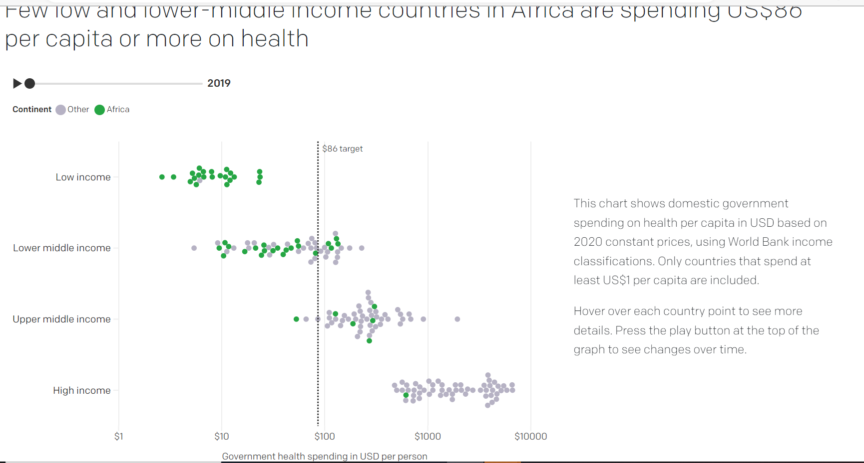
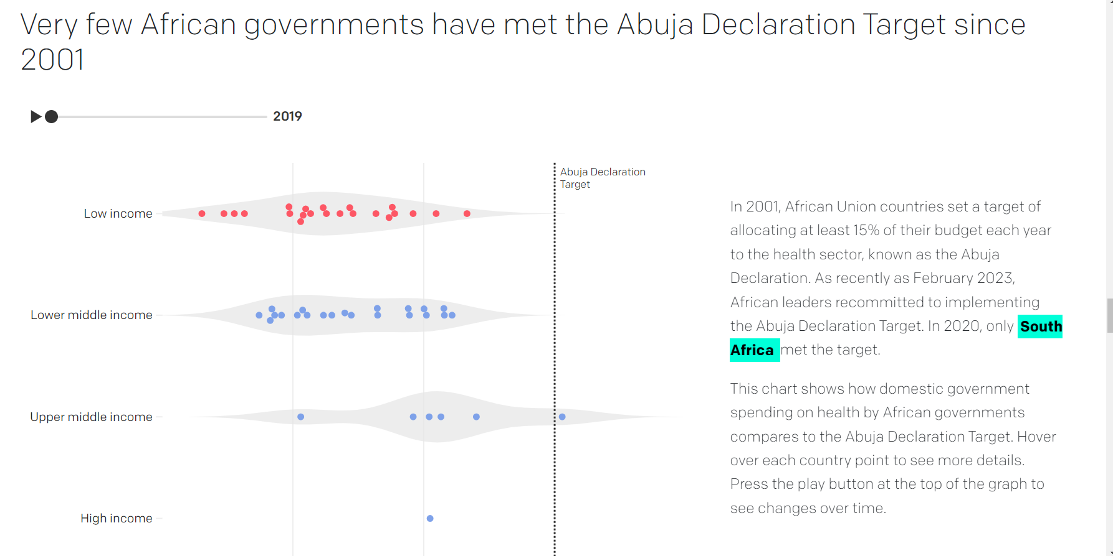

Slide 8
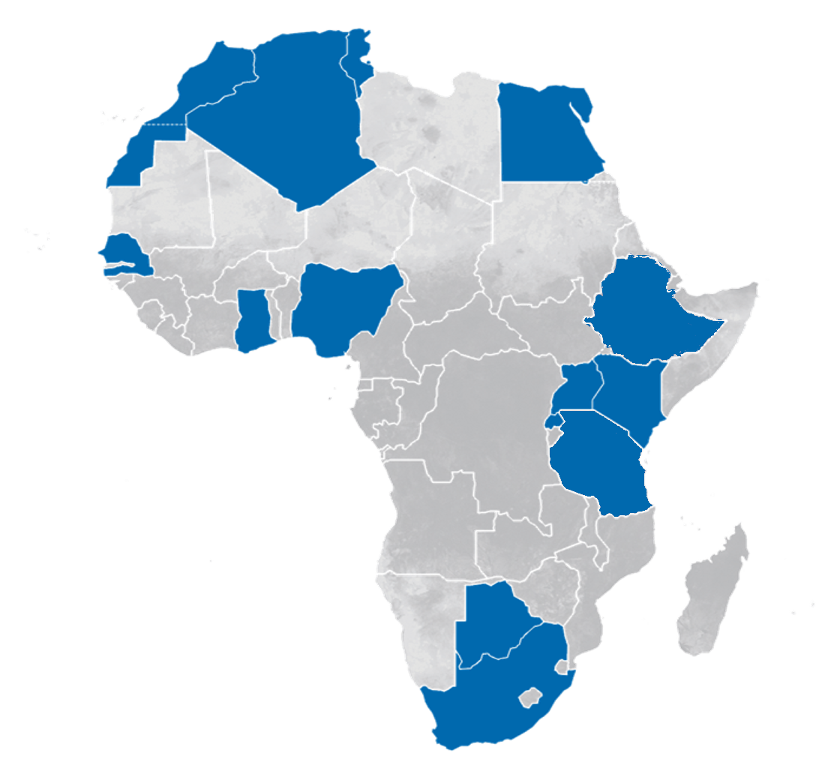
4
Massive vaccine manufacturing efforts kicked off across Africa, currently mostly focusing on COVID-19 vaccines
Algeria
Botswana
Egypt*
Ethiopia
Ghana
Kenya
Morocco
Nigeria*
Rwanda
Senegal*
S. Africa*
Tanzania
Tunisia*
Uganda
ENSURE HEALTHY MARKETS FOR VACCINES AND RELATED PRODUCTS
*mRNA Tech Transfer Hub
started
planned
discussions
Source: “LVM-Landscape-Baseline-June-01-2022” database of LVM commitments; CHAI calculations as of June 16, 2022

Slide 9
From Charity to Solidarity: Building a Networked Platform for Equitable Countermeasures for the Pandemic Age

Slide 10
A new PCM Platform must:
Put people back at the heart of health policy
Put human rights at the heart of the design of a future platform
As a guiding principle, ensure a future platform maximizes health outcomes for all, including the most vulnerable across society and those in low resource settings
Design structures, policies and operating systems that put business in the service of health outcomes in the event of a public health emergency or potential pandemic, not vice versa
Equitable governance
Be convened and designed by LMIC regions and governments from the outset
Ensure ongoing meaningful representation of LMICs with clear, equitable criteria (population/demographic defined) of inclusion at all decision-making levels and at the earliest stages;
Be underpinned by a common principle of shared global risks of pandemic threats and the imperative of shared responsibility to manage them.
Advance sustainable funding plans, such as leveraging the Global Public Investment model, to end the over-reliance on funding from HICs or private capital.

Slide 11
A new PCM Platform must:
Networked and distributed capacity
Establish regional and sub-regional R&D hubs working collectively with new technologies without intellectual property (IP) restraints, and engage stakeholders that will use these tools early in the R&D process;
Expand distributed manufacturing capacity of countermeasures across regions, especially in LMICs, with the rights to adapt technologies and use them for other purposes;
Knowledge and knowhow sharing
Back and develop policies to increase knowledge sharing, remove trade-related barriers including IP, and create tech transfer hubs that are also equipped for R&D;
Call for publicly financed research to guarantee global equitable and affordable access to the countermeasures it funded, as well as underlying technologies;
Accountability and delivery
Ensure the production, pricing, supply, financing, and delivery of pandemic countermeasures can be tracked from production to patients during a pandemic.

Slide 12
How PAN envisages role of CSOs in an African Advocacy Network
Evolving from Pandemic Action Network’s unique collective advocacy model, we’re building an independent African Advocacy Network to uniquely fill African policy and advocacy gaps and advance progress on Africa’s pandemic prevention, preparedness, and response capacities, health resilience, and related issues.
Our “network of networks” will connect national and regional priorities to global processes while delivering collectively with:
Policy, advocacy, and communications acumen
Influence and convening power
Network effect — connecting and collaborating across issues, sectors, expertise, and geographies
action
legislation
impact
policy
+
advocacy
recommendations
reports
research
Notes:
Policy, advocacy, and communications acumen We have built a seasoned global team of advocates with deep experience and success in navigating policymaking processes globally and in specific markets, setting and moving global health and development policy agendas, building political support, and mobilizing resources.
Influence and convening power Across our global team and Network, we have strong and trusted relationships with leaders, policymakers, funders, implementers, advocates, innovators, and influencers representing a wide array of geographies.
The Network effect Our collaborative Network advocacy model means that our core team does not have to do everything. We are quick to put the wind in the sails of catalytic efforts led by our partners, and also to lift up and give credit to others to ensure that the right message is delivered by the right voices at the right time.

Slide 13
Who should we target and why?
Who is our audience? What do we want them to do?
 | PARTNERS & FUNDERS (network and donors) | KEY OPINION LEADERS (influence the narrative and decision-makers) | POLICYMAKERS (have a global or national platform to take policy action) | PEOPLE WHO CARE (willing to speak up on our issues -— likely have a personal experience to share)
ACTIONS & DESIRED OUTCOMES | Shape agendas Be an advocate — stand with us See the Network as valuable Continue to be active and invested in this space Include us in their work | Buy inti the agenda Speak up and amplify | Take action on our agendas | Continue to practice behaviors that stop the spread of COVID-19 Speak up and pressure decision-makers Like, comment, subscribe to amplify calls-to-action Join us, show up when asked

Slide 14
Our Mission
Drive collective action to end the COVID-19 crisis and to ensure the world is prepared for the next pandemic.

Slide 15
Communications Goals
What do we aim to achieve with communications?
Position Resilience Action Network Africa (as a platform for PPR concerned CSOs) as a go-to voice and resource for content on COVID-19 response and pandemic preparedness policy / advocacy priorities
Be an amplifying platform for Network partners
Expand audience of advocates, funders, and activists in the pandemic preparedness and response space
Help slow the spread of COVID-19

Slide 16
Network Communicators Working Group
How will we deepen engagement and diversify voices across our Network?
A tactical Network Communicators
Working Group (held monthly)
comprised of the communications leads from our most active partners will fuel partner-centric content and editorial calendar sharing.
RESILIENCE ACTION NETWORK AFRICA

Slide 17
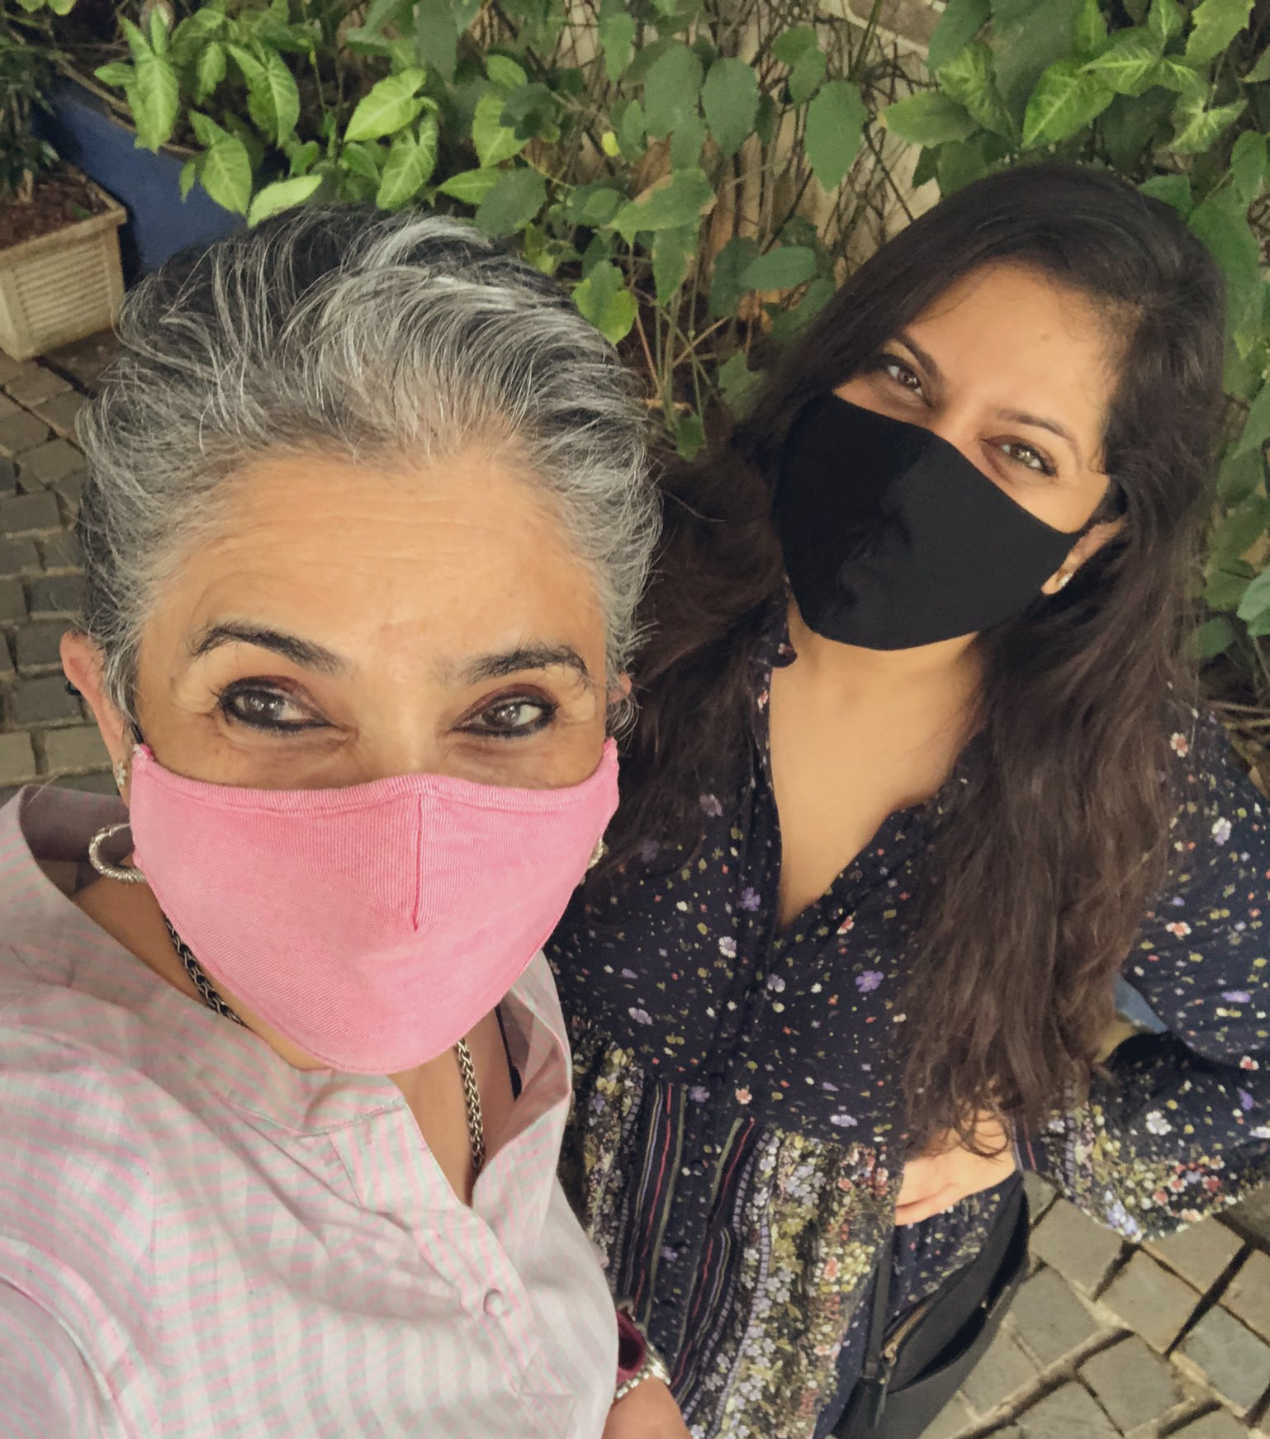
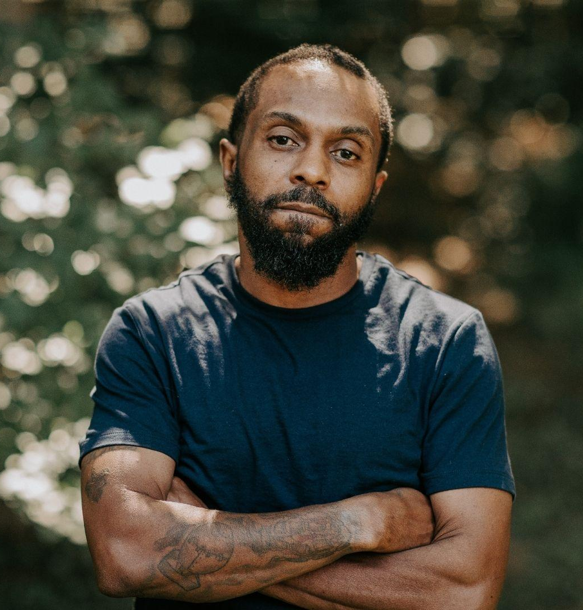
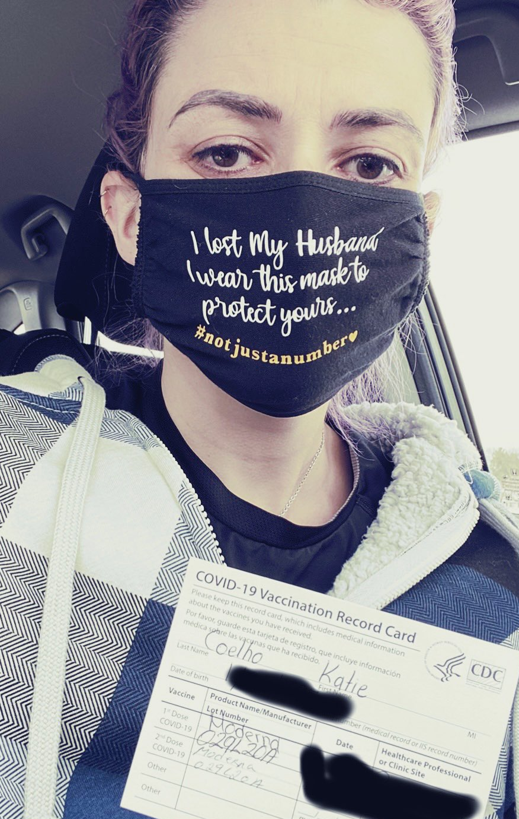
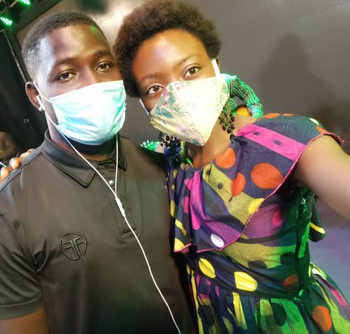
Communicating Human Impact
Introducing “Pandemic Action Ambassadors”
Idea:
Numbers are not enough to create the political will to act. Emotional storytelling — from the frontlines of this pandemic — is key to ending this pandemic and preventing the next.
Pandemic Action Network’s Ambassador program
A global group of people who care that have been impacted by the COVID-19 pandemic and are committed to using their voices to accelerate an end to this crisis and ensure we learn the lessons of this tragedy so that the world is better prepared for future pandemics.
We will call Ambassadors to action, but also spotlight them, so this program will have both push and pull to drive engagement.
Primary content formats:
Integrate Pandemic Action Ambassador stories into blog and social content placements (short videos, animated/graphic stories), Pandemic Action Network campaigns and Network opportunities, advocacy and media opportunities
Story elements:
Human experiences: Illustrating the impact of delayed action; how policy can impact individuals
Calls-to-action: Provide direction and inspire further action
Tone:
Authentic
Personable
Distribution:
Across owned and shared partner media channels

Slide 18
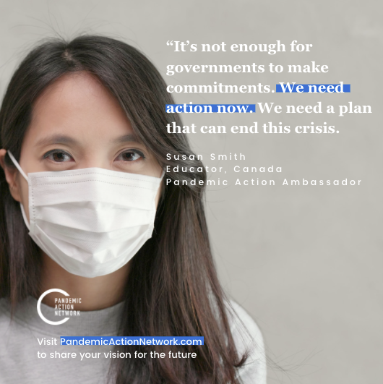
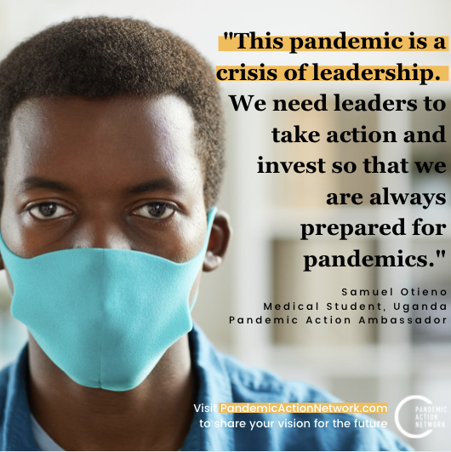

Slide 19
Proactive planning to capture advocacy windows/ Moments
Proactive - Priority Moments
Reactive - Communicate Around/Leverage Partners
ONE Campaign Week of Action
2nd Global COVID-19 Summit
US-Africa Leaders Summit
UN High-Level Summit on GHS/Preparedness
WHO Executive Board -
AU-EU Summit
WBG-IMF Spring Meetings
G7 Leaders’ Summit
17-19 Feb
TBD Mar
TBD April?
18-23 April
11-13 June
TBD June
15-22 Jan
24-29 Jan
TBD Feb
9 March
25-29 April
28 June-1 July
World Immunization Week
22-28 May
AU Leaders’ Summit
CEPI 2.0 Replenishment
Global Health Security Conference (Singapore)
World Health Assembly
8 March
IWD
Notes:
Autumn

